Slide 1


MicroPython Clocks and Watches: Timekeeping Meets Coding
Explore the intersection of timekeeping, art, and computational thinking. This guide introduces students to building customized clocks and watches using low-cost parts and MicroPython code.
by Dan McCreary

Slide 2
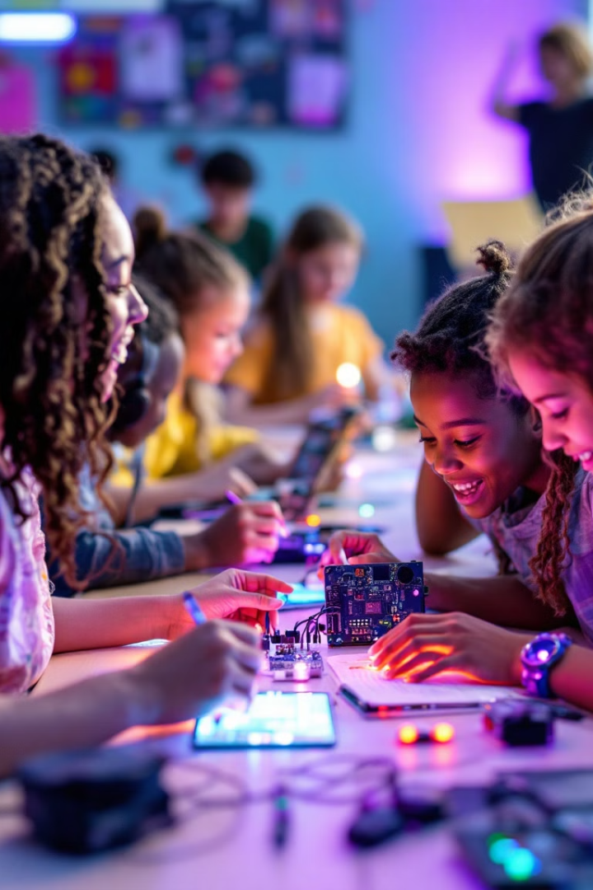
Why This Book?
1
Student Fascination
2
Project-Based Learning
STEM students are excited about timekeeping projects. They're motivated to learn Python for customized devices.
Students pick their own projects. Rich set of starter projects available for modification.
3
Hands-On Approach
Fixing and modifying projects leads to faster learning than traditional lectures.

Slide 3
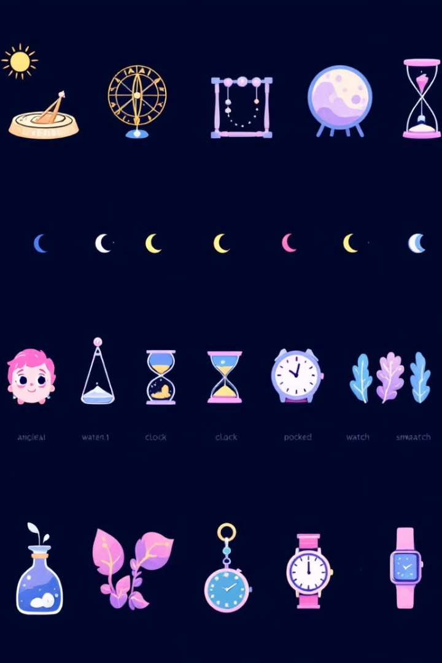
The Allure of Timekeeping
1
Ancient Sundials
Humans have always been fascinated by measuring time.
2
Modern Smartwatches
Digital innovation continues to drive timekeeping forward.
3
MicroPython Projects
Serve as an entry point to coding and computational thinking.

Slide 4




Tapping into Child Curiosity
Wonder
Questions
1
Children are captivated by the ticking of clocks and changing digital displays.
They ask how it works and what makes it tick.
2
Learning
4
Creation
The process kindles creativity and innovation.
3
MicroPython projects allow them to create their own timekeeping devices.

Slide 5
From Lectures to Tangible Results
Traditional Method
Project-Based Learning
MicroPython Clock Project
Long lectures often fail to hold young learners' attention.
Children become active creators, not passive recipients of information.
A journey in problem-solving, critical thinking, and perseverance.

Slide 6




Building Blocks of Computational Thinking
Problem Solving
1
Approach problems logically
Task Breakdown
2
Break problems into smaller tasks
Efficient Solutions
3
Find optimal ways to solve issues
Practical Application
4
Create timekeeping devices

Slide 7
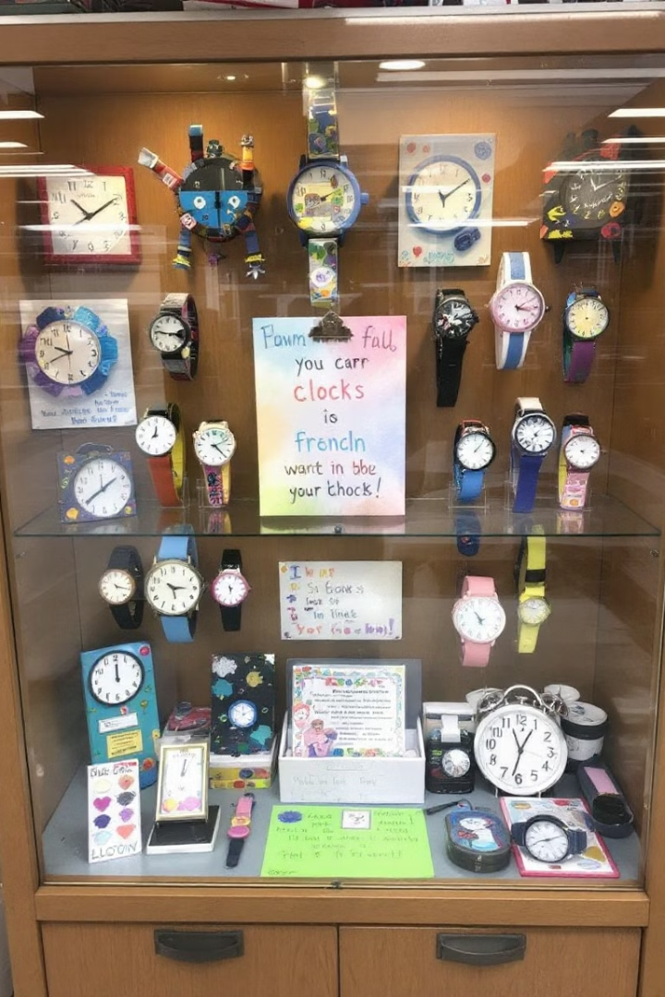
Social Construction: Shared Creation
Display Case
Unique Stories
Showcase clocks and watches in school libraries.
Each device represents a young coder's journey.
Collaborative Learning
Children learn from each other, fostering teamwork and community.

Slide 8

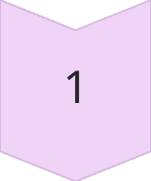
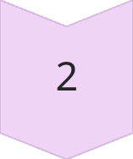
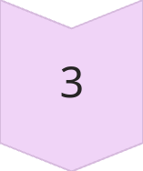
Evolution of Learning: From ATmega328P to Raspberry Pi
2014: ATmega328P
Required deep knowledge and low-level C programming.
Today: Raspberry Pi
Runs full Python interpreter with 264K RAM.
Future: AI-Assisted
Novice programmers can quickly achieve great things.

